Slide 1
Introduction to Databases
What we learned in first trimester

Slide 2

Computer system

Slide 3
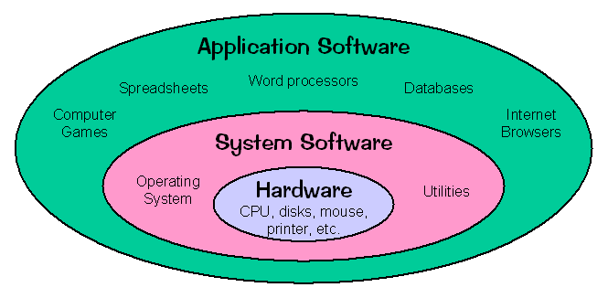
Types of Software's

Slide 4

Application Software's

Slide 5
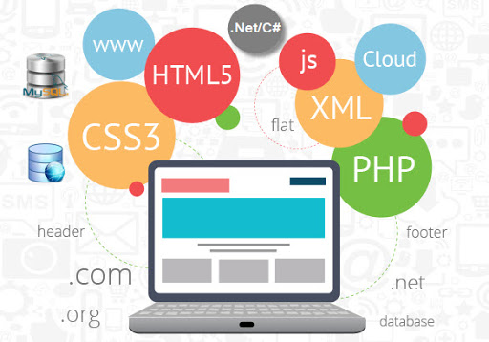
Software is made of …………….

Slide 6
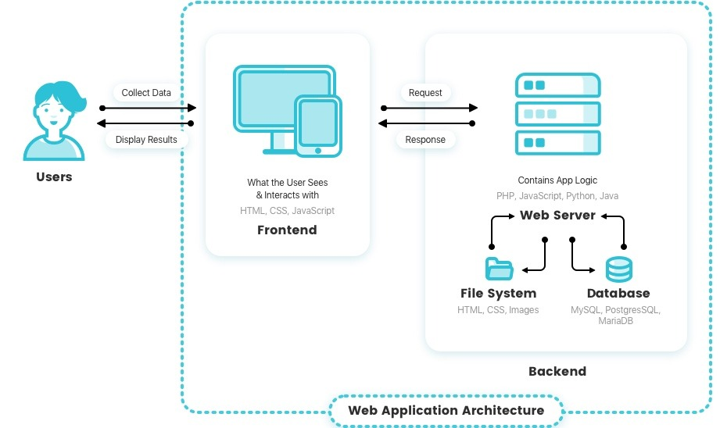
Frontend and Backend of software

Slide 7

Database

Slide 8
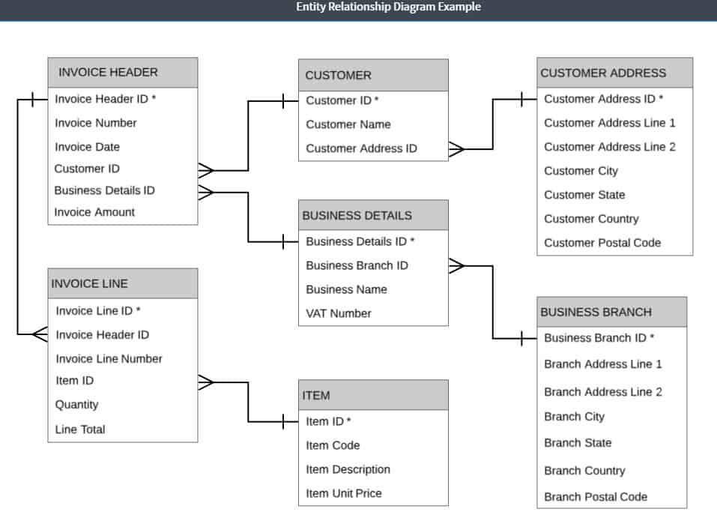
Relational Databases

Slide 9
Chapter 1 :Database Management System
Drawbacks of using files to store data
Purpose of database systems
Definition of DBMS
Comparison of File processing system & DBMS
Limitation of file processing system Advantages and Disadvantages of DBMS
Users of DBMS
Overall system structure

Slide 10
Chapter 2 :Entity-Relationship Model
Entities and Entity Sets
Relationships and Relationships Sets
Attributes
Mapping cardinalities
Entity Relationship Diagram

Slide 11
Chapter 3 :Relational Model
Structure of relational database
Terms - Relation, Tuple,
Terms -Attribute, Cardinality
Keys - Super Key , Candidate Key, Primary Key, Foreign Key
Conversion of ER Diagram to Relational Model
Conversion of relational schema to 3NF

Slide 12
Chapter 4 : SQL (Structured Query Language)
Introduction, history Of SQL
Definition
basics structure of SQL
DDL Commands: CREATE,
DROP,ALTER
Data types and constraints
DML Command: INSERT,UPDATE,
DELETE,SELECT
Simple queries

Slide 13
Chapter 5 : Advanced Queries using SQL
Aggregate function
Set operations
Order by, Group by, Having clauses
SQL mechanisms for joining relations (inner joins, outer joins and their types)
Nested queries

Slide 14
Trimester - II
Relational Database Management System
Advanced SQL
Relational Database Design
Transactions and concurrency control mechanism
Crash Recovery

Slide 15
Advanced SQL
1.1 Controlling the program flow, conditional statements, loops
1.2 Views, Stored Functions
1.3 Handling errors and exceptions
1.4 Cursors, Triggers

Slide 16
Account ( cno ,cname,ano, atype, balance)
Select * from account where atype=‘saving’;

Slide 17
Relational Database Design
2.1 Pitfalls in Relational-Database
2.2 Functional dependencies
2.3 Closure of Functional dependencies (F+)
2.4 Closure of an Attribute set
2.5 Algorithm to derive a Primary Key for a relation and examples
2.6 Concept of Decomposition
2.7 Desirable Properties of Decomposition 7.5 Concept of Normalization
2.8 Normal forms : 1NF, 2NF, 3NF, BCNF

Slide 18
Transactions and concurrency control mechanism
3.1 Describe a transaction, properties of transaction, state of the transaction. Executing transactions concurrently associated problem in concurrent execution.
3.2 Schedules
3.3 types of schedules
3.4 concept of Serializability,
3.5 Precedence graph for Serializability.
3.6 Ensuring Serializability by locks, different lock modes, 2PL and its variations.
3.7 Basic timestamp method for concurrency, Thomas Write Rule.
3.8 Locks with multiple granularity, dynamic database concurrency (Phantom Problem).
3.9 Timestamps versus locking.
1.10 Deadlock handling methods
3.11Detection and Recovery (Wait for graph).
3.12Prevention algorithms (Wound-wait, Wait-die)

Slide 19
Account ( ano , atype , balance)
Read(A)
A= A-5000 Read( 10000)
Write (A)

Slide 20
Crash Recovery
4.1 Failure classification
4.2 Recovery concepts
4.3 Log base recovery techniques (Deferred and Immediate update)
4.4 Checkpoints
4.5 Recovery with concurrent transactions (Rollback, checkpoints, commit)

